Slide 1
Foreign Key
Foreign key maintains referential integrity
Referenced table (Parent table)
Insertion – No violation
Deletion – May cause violation
on delete cascade
Updation – May cause violation

Slide 2
Foreign Key
Foreign key maintains referential integrity
Referencing table (Child table)
Insertion – May cause violation
Deletion – No violation
Updation – May cause violation

Slide 3
Foreign Key
ON DELETE CASCADE
Is used to automatically remove the matching records from the child table when we delete the rows from the parent table.
It is a kind of referential action related to the foreign key.

Slide 4
Foreign Key
ON DELETE CASCADE
CREATE TABLE Employee (
emp_id int(10) NOT NULL,
name varchar(40) NOT NULL,
birthdate date NOT NULL,
gender varchar(10) NOT NULL,
hire_date date NOT NULL,
PRIMARY KEY (emp_id)
);

Slide 5
Foreign Key
ON DELETE CASCADE
CREATE TABLE Payment (
payment_id int(10) PRIMARY KEY NOT NULL,
emp_id int(10) NOT NULL,
amount float NOT NULL,
payment_date date NOT NULL,
FOREIGN KEY (emp_id) REFERENCES Employee (emp_id) ON DELETE CASCADE
);

Slide 6
Foreign Key
ON DELETE CASCADE
CREATE TABLE Payment (
payment_id int(10) PRIMARY KEY NOT NULL,
emp_id int(10) NOT NULL,
amount float NOT NULL,
payment_date date NOT NULL,
FOREIGN KEY (emp_id) REFERENCES Employee (emp_id) ON DELETE CASCADE
);

Slide 7
Foreign Key
ON DELETE CASCADE
CREATE TABLE Payment (
payment_id int(10) PRIMARY KEY NOT NULL,
emp_id int(10) NOT NULL,
amount float NOT NULL,
payment_date date NOT NULL,
FOREIGN KEY (emp_id) REFERENCES Employee (emp_id) ON DELETE CASCADE
);

Slide 8
Join
A join is an SQL operation performed to establish a connection between two or more database tables based on matching columns, thereby creating a relationship between the tables.
Types :
Cross(cartesian) Join
Natural Join
Equi Join
Self Join
Conditional Join
Outer Join
Left outer join
Right outer join
Full Join
b

Slide 9
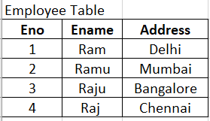
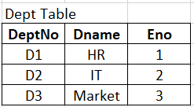
Join

Slide 10
Join
Join is possible only if common attribute is existing between both tables.
Join is cross product + condition (select statement)

Slide 11
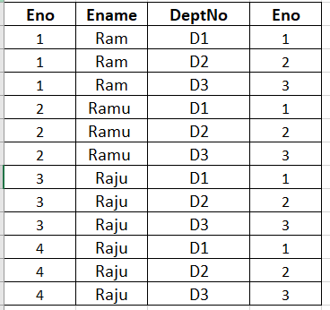
Natural Join
Cross product is one row of table A is multiplied with all row of the other table B.
Cross product is AXB = 12 rows
Find the employee who is working in a department
Select ename from emp,dept where emp.eno = dept.eno
Natural Join : is used when common attribute values are equal.

Slide 12
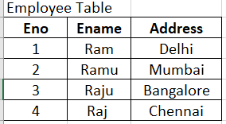
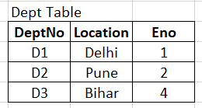
Equi Join
Equi Join is used when any attribute values are equal.
Find the empname who worked in a department having location same as their address.
Select ename from emp, dept where emp.eno = dept.eno and emp.address = dept.location

Slide 13
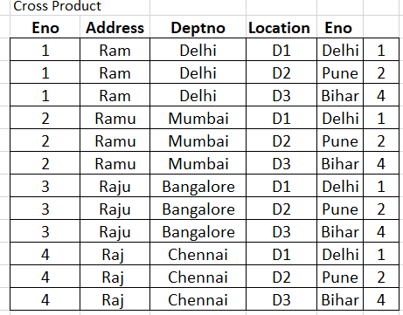
Equi Join
Select ename from emp, dept where emp.eno = dept.eno and emp.address = dept.location

Slide 14
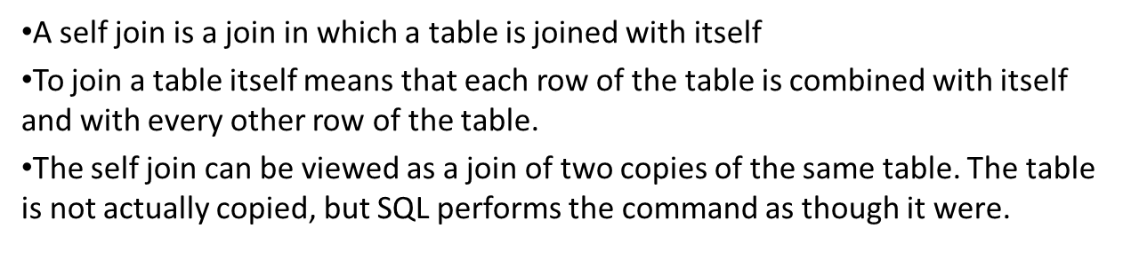
Self Join
SELECT column_name(s)
FROM table1 T1, table1 T2
WHERE condition;
T1 and T2 are different table aliases for the same table.

Slide 15
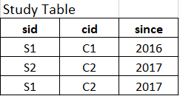
Self Join
Find studentid who is enrolled in atleast two courses.
Select T1.sid from study as T1, study as T2 where T1.sid = T2.sid and T1.cid <> T2.cid

Slide 16
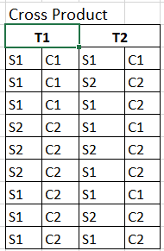
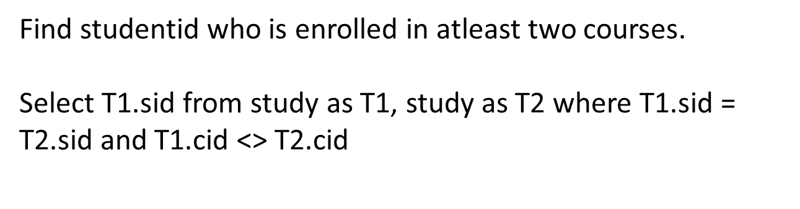
Self Join

Slide 17
SQL queries and subqueries

